Slide 1
Unifying GitLab CI approaches for the Linux Kernel
Helen Koike
Sebastian Fricke
LPC 2024

Slide 2
What is DRM-CI?

Slide 3
DRM-CI: what is it?
GitLab-CI pipeline to test DRM
In kernel tree
Uses Freedesktop infrastructure
Annotated expectation files
How to use:
  Add your repository to gitlab.freedesktop.org
  Request access to drm-ok group
  Trigger pipelines

Slide 4
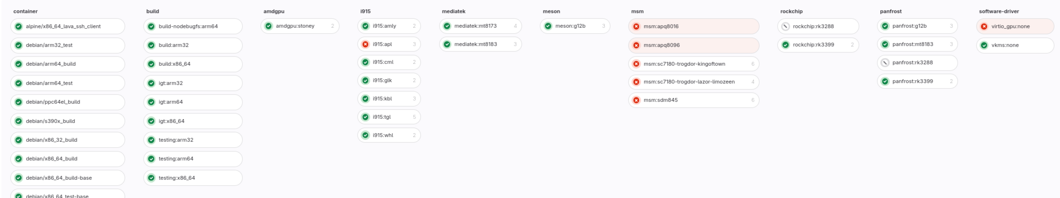
DRM-CI: current pipeline

Slide 5
How others are doing it?

Slide 6
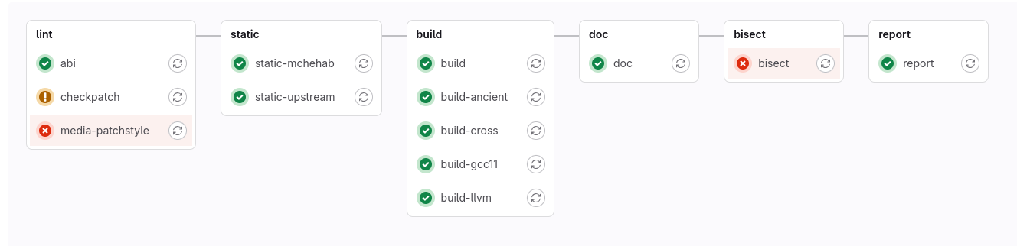
Media-CI
Recent out-of-tree pipeline on Freedesktop

Slide 7
KCI-GITLAB: common base

Slide 8
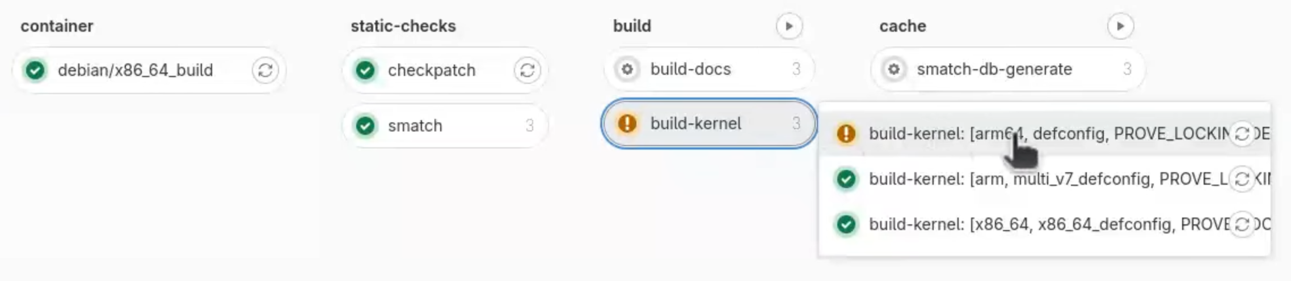
KCI-GITLAB: details
Patch v1 submitted on 28th Feb 2024
Meant to be common base
Test-scenarios feature
  Allow override jobs (in-tree)
  Easily share test-scenarios

Slide 9
Overview of differences and similarities

Slide 10
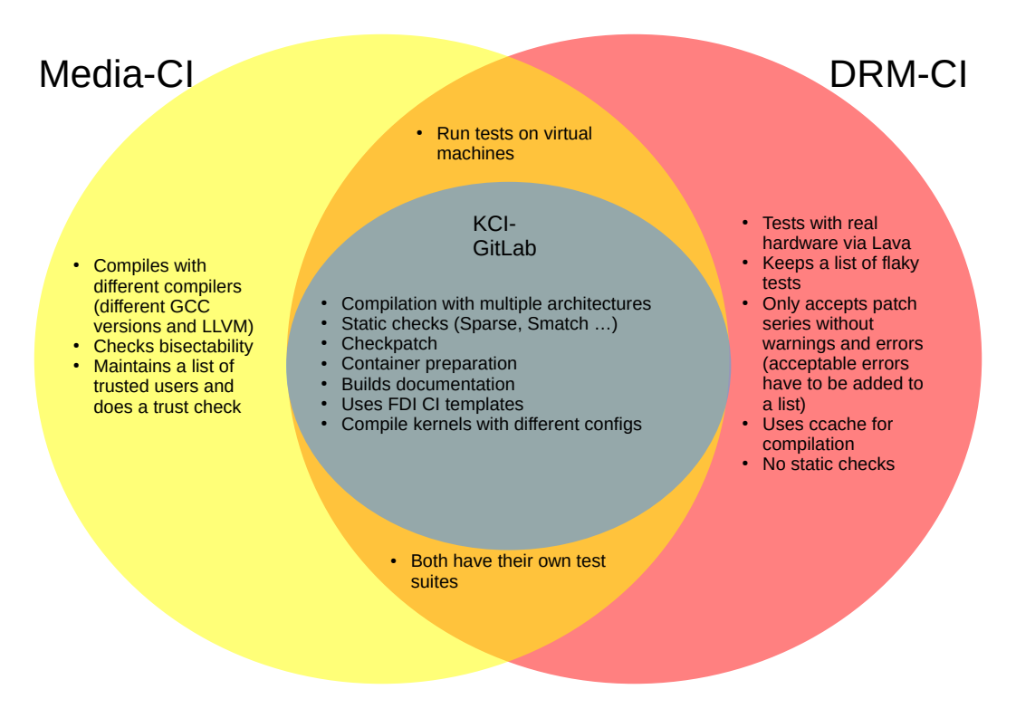

Slide 11
How DRM-CI profit from KCI-GITLAB?
Get static checks
Easier to specify Test Scenarios (per driver, per maintainer, etc)
Independent of platform
Base for other tests (kselftests, kunit, etc...)

Slide 12
What is the problem?

Slide 13
What is the problem?
Duplicated and inefficient efforts
Not being up to date with latest best practices
Not benefiting or contributing to other’s work
Individual infrastructure
High entrance barrier to subsystems without an existing CI system

Slide 14
Why should you care?
Reduced maintenance cost
More reviewers to DRM-CI
Access to other tests and infrastructure
Contribute to the Linux testing ecosystem as a whole

Slide 15
Potential down sides
Slower to make changes:
  More reviews and tests required
  Designing changes is more complicated
Specific to GitLab

Slide 16
Steps to migrate to KCI-GITLAB
Step 1: Finish upstreaming KCI-GITLAB
  Move KCI-GITLAB to tools/ci/ folder with more generic script (“library” like)
  Utilize these scripts from tools/ci in DRM-CI
  Submit v2 of KCI-GITLAB
  Work estimation in total: 2 weeks FTE (2 days for 1.2)
Step 2: Move DRM-CI definition as a Scenario to KCI-GITLAB
  Dependent on KernelCI Labs to dispatch tests to devices
  Re-implement dependencies from MesaCI in KCI-GITLAB
  Write DRM Scenario in KCI-GITLAB
  Work estimation in total: 2 weeks FTE

Slide 17
Questions for the audience
What do you think about handling board lab access via the KernelCI? (instead of doing that via Mesa-CI)
What are you currently missing in the DRM-CI?
Do you have an idea for funding?
How should we organize CI development and maintainance workflow?

Slide 18
Thank you!

